Slide 1
Assignment 3 Q&A
Xu Wang

Slide 2
Canny Edge Detector
Filtered gradient
Nonmaximum suppression
Hysteresis thresholding

Slide 3
Filtered Gradient
Gaussian filtering
Compute the Gradient

Slide 4
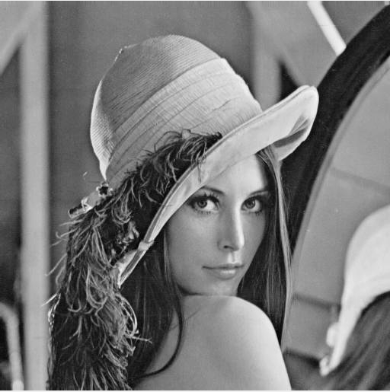
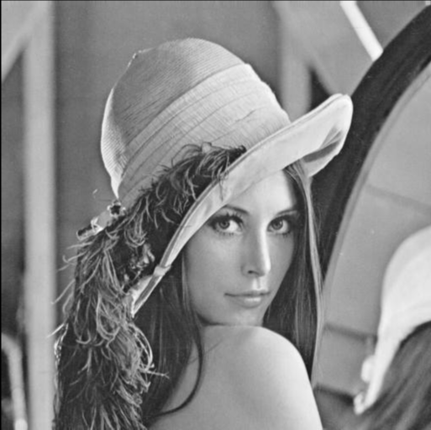
Gaussian filtering

Slide 5
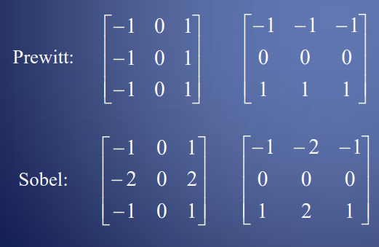

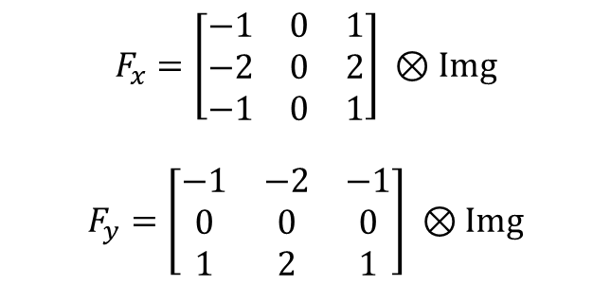
Gradient
Convolve the Gaussian filtered image with Prewitt or Sobel operator
magnitude and orientation of the Gradient
$F= \sqrt{{F_{x}}^{2}+ {F_{y}}^{2}}$
$D=arctan⁡(F_{y}/F_{x})$
$$F_{x}=\left[\begin{matrix}−1 & 0 & 1 \\ −2 & 0 & 2 \\ −1 & 0 & 1\end{matrix}\right] ⊗Img$$
$$F_{y}=\left[\begin{matrix}−1 & −2 & −1 \\ 0 & 0 & 0 \\ 1 & 2 & 1\end{matrix}\right] ⊗Img$$

Slide 6
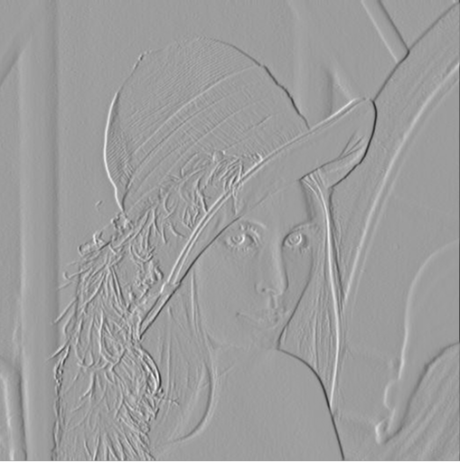
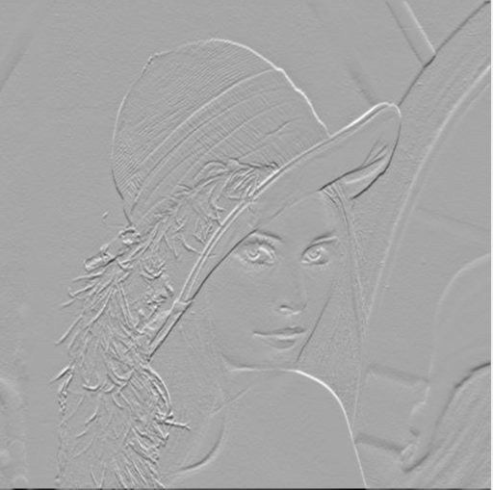
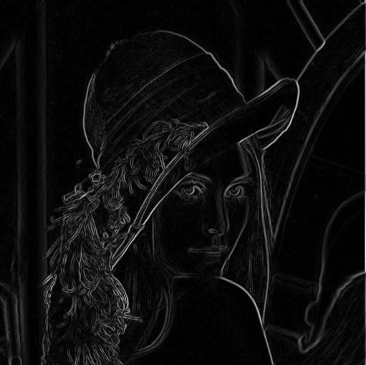
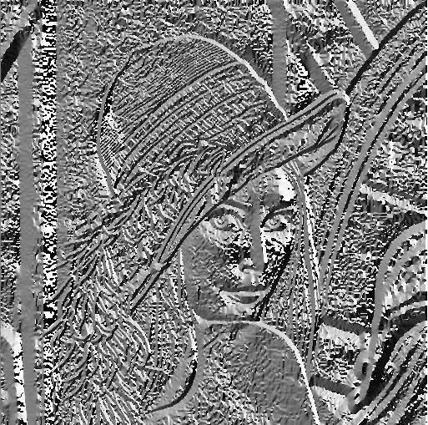
Fx
Fy
F
D

Slide 7
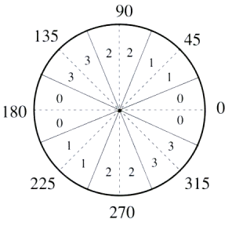
Nonmaximum suppression
For each pixel find the direction D* in (0, 45, 90, 135) that is closest to the orientation D at that pixel
If the edge strength F(x,y) is smaller than at least one of its neighbors along D*, set I(x,y) = 0, else set I(x,y) = F(x,y)

Slide 8
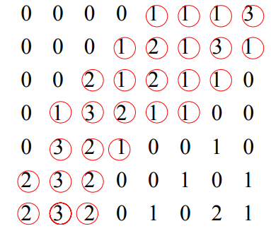
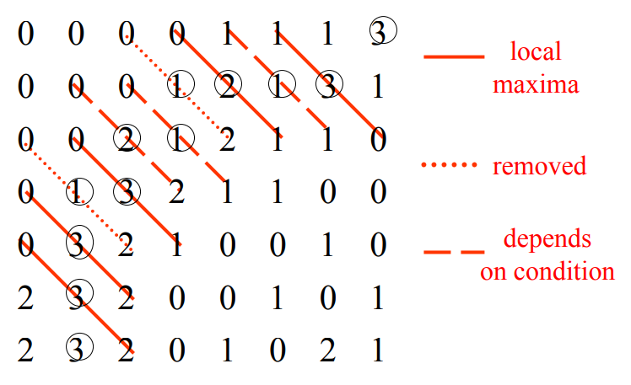
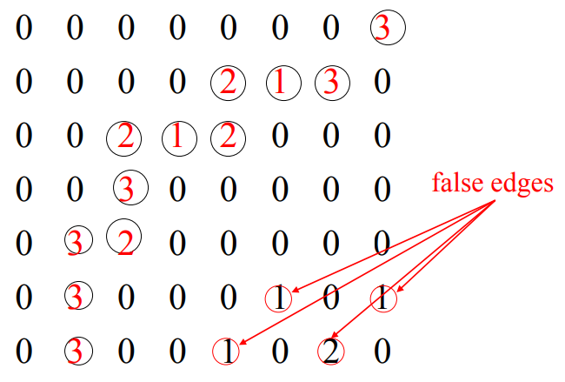

Slide 9
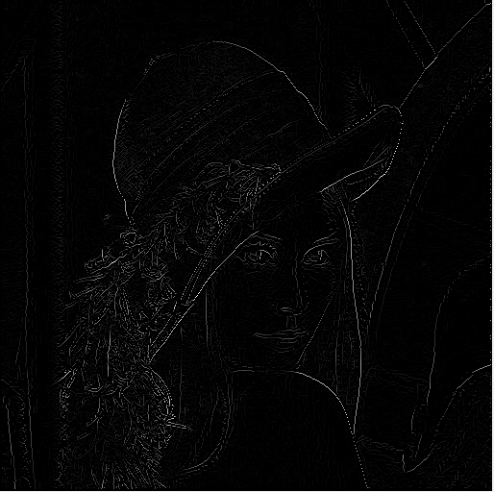

Slide 10
Hysteresis thresholding
Set threshold T_h and T_l
Locate the next unvisited pixel (x,y) such that I(x,y) > T_h
Starting from (x,y), follow the chain of connected local maxima, in both directions, as long as I(x,y) > T_l
Mark each pixel as it is visited

Slide 11
